Slide 1
Android Boot Camp for Developers Using Java, 3E
Chapter 4: Explore! Icons and Decision-Making Controls

Slide 2
Objectives
In this chapter, you learn to:
Create an Android project with a custom icon
Change the text color in controls using hexadecimal colors
Align controls using the gravity properties
Determine layout with the layout:margin properties
Place a RadioGroup and RadioButtons in Android applications
Write code for a RadioGroup control

Slide 3
Objectives (continued)
Make decisions using an If statement
Make decisions using an If Else statement
Make decisions using logical operators
Display an Android toast notification
Test the isChecked property
Make decisions using nested if statements

Slide 4
The Medical Calculator App
We will be creating an app to convert pounds to kilograms and kilograms to pounds
Formulas needed:
Kilograms = pounds * 2.2
Pounds = kilograms / 2.2
App is designed to be used in a hospital setting to administer medication to patients based on patient weight
Hospital scales register pounds
Meds (based on patient weight) dispensed in kilograms

Slide 5
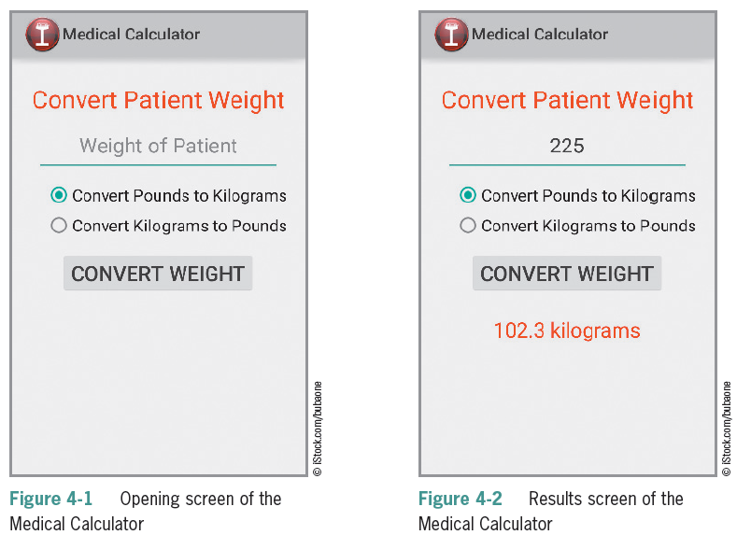
The Medical Calculator App (continued)

Slide 6
The Medical Calculator App (continued)
Steps to complete the App
Create a customized launcher icon.
Add the icon using code to display in the ActionBar.
Define a TextField for the data entry of the weight of the patient.
Define a RadioGroup to select pounds to kilograms or kilograms to pounds.
Display a Toast message for data validation.
Convert data so it can be used for arithmetic operations.
Perform arithmetic operations on data the user enters.
Display formatted results.

Slide 7
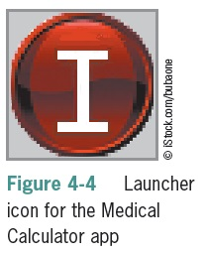
The Launcher Icon
The Launcher Icon allows you to view which apps are available
High-quality launcher icons can influence users to purchase your app
Icons can establish brand identity
Simple images with clear visual cues have a memorable impact
Icon dimensions are 72 X 72 pixels for the high-density screen
Vector graphics as best for icon design because images are easily resized

Slide 8
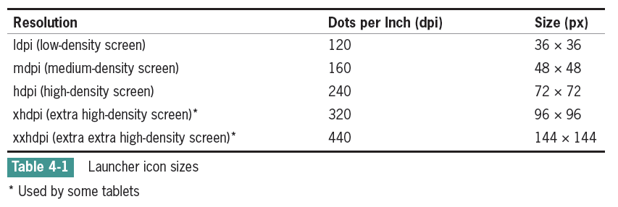
The Launcher Icon (continued)
When you publish an app to the Android Market, you must provide a 512 × 512 pixel, high-resolution application icon in the developer console as you upload your program. This icon is displayed in the Android Market to provide a description of the app and does not replace your launcher icon.

Slide 9
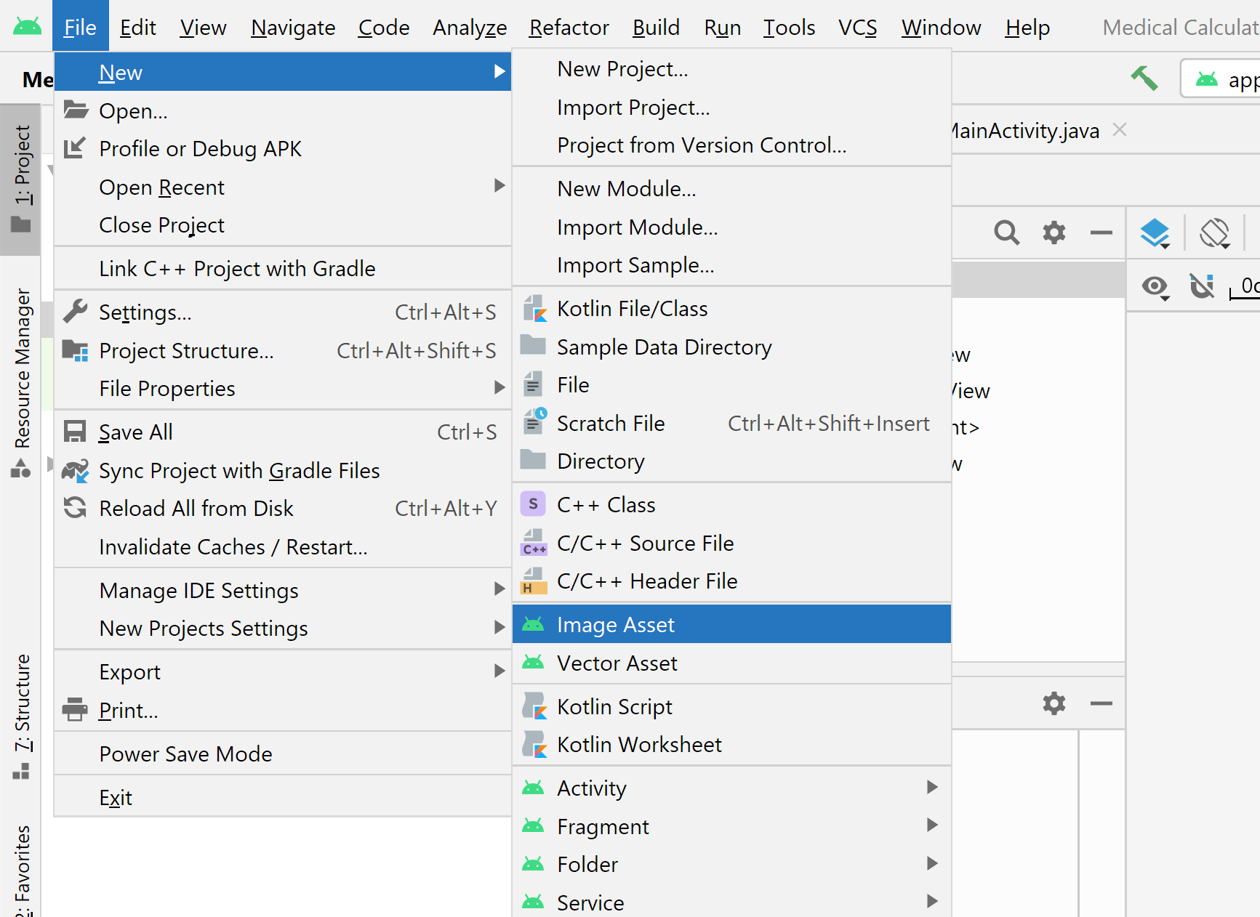
The Launcher Icon (continued)
Customizing a Launcher Icon
Image Asset

Slide 10
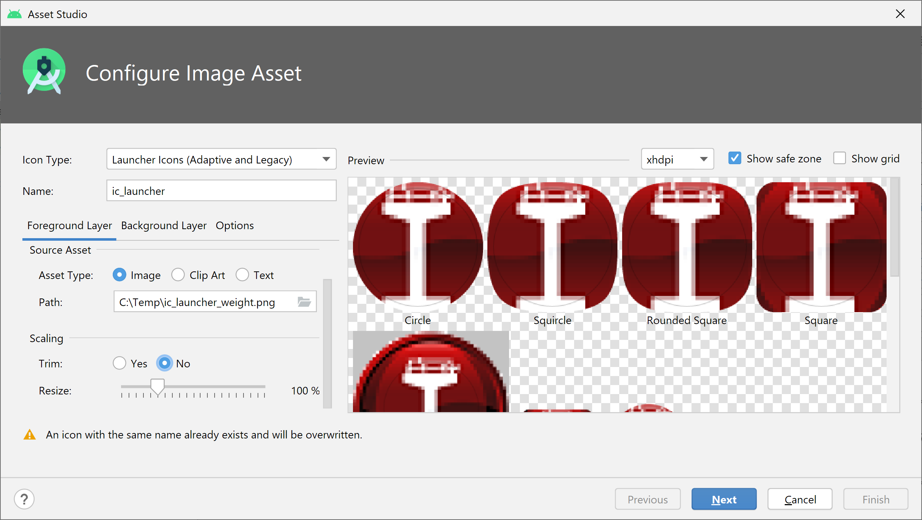
The Launcher Icon (continued)
Customizing a Launcher Icon
Path: ic_launcher_weight.png

Slide 11
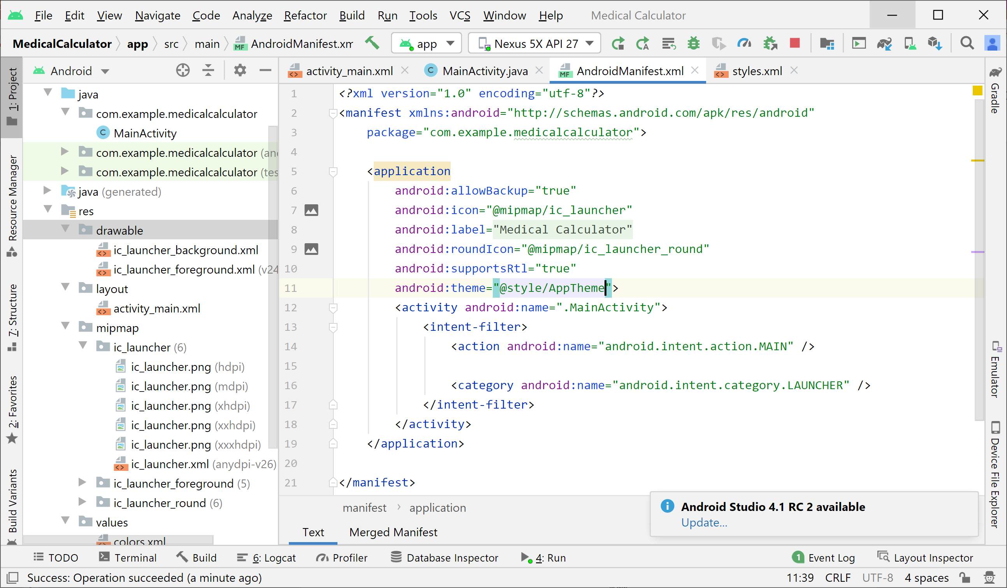
The Launcher Icon (continued)
AndroidManifest.xml
@style/AppTheme

Slide 12
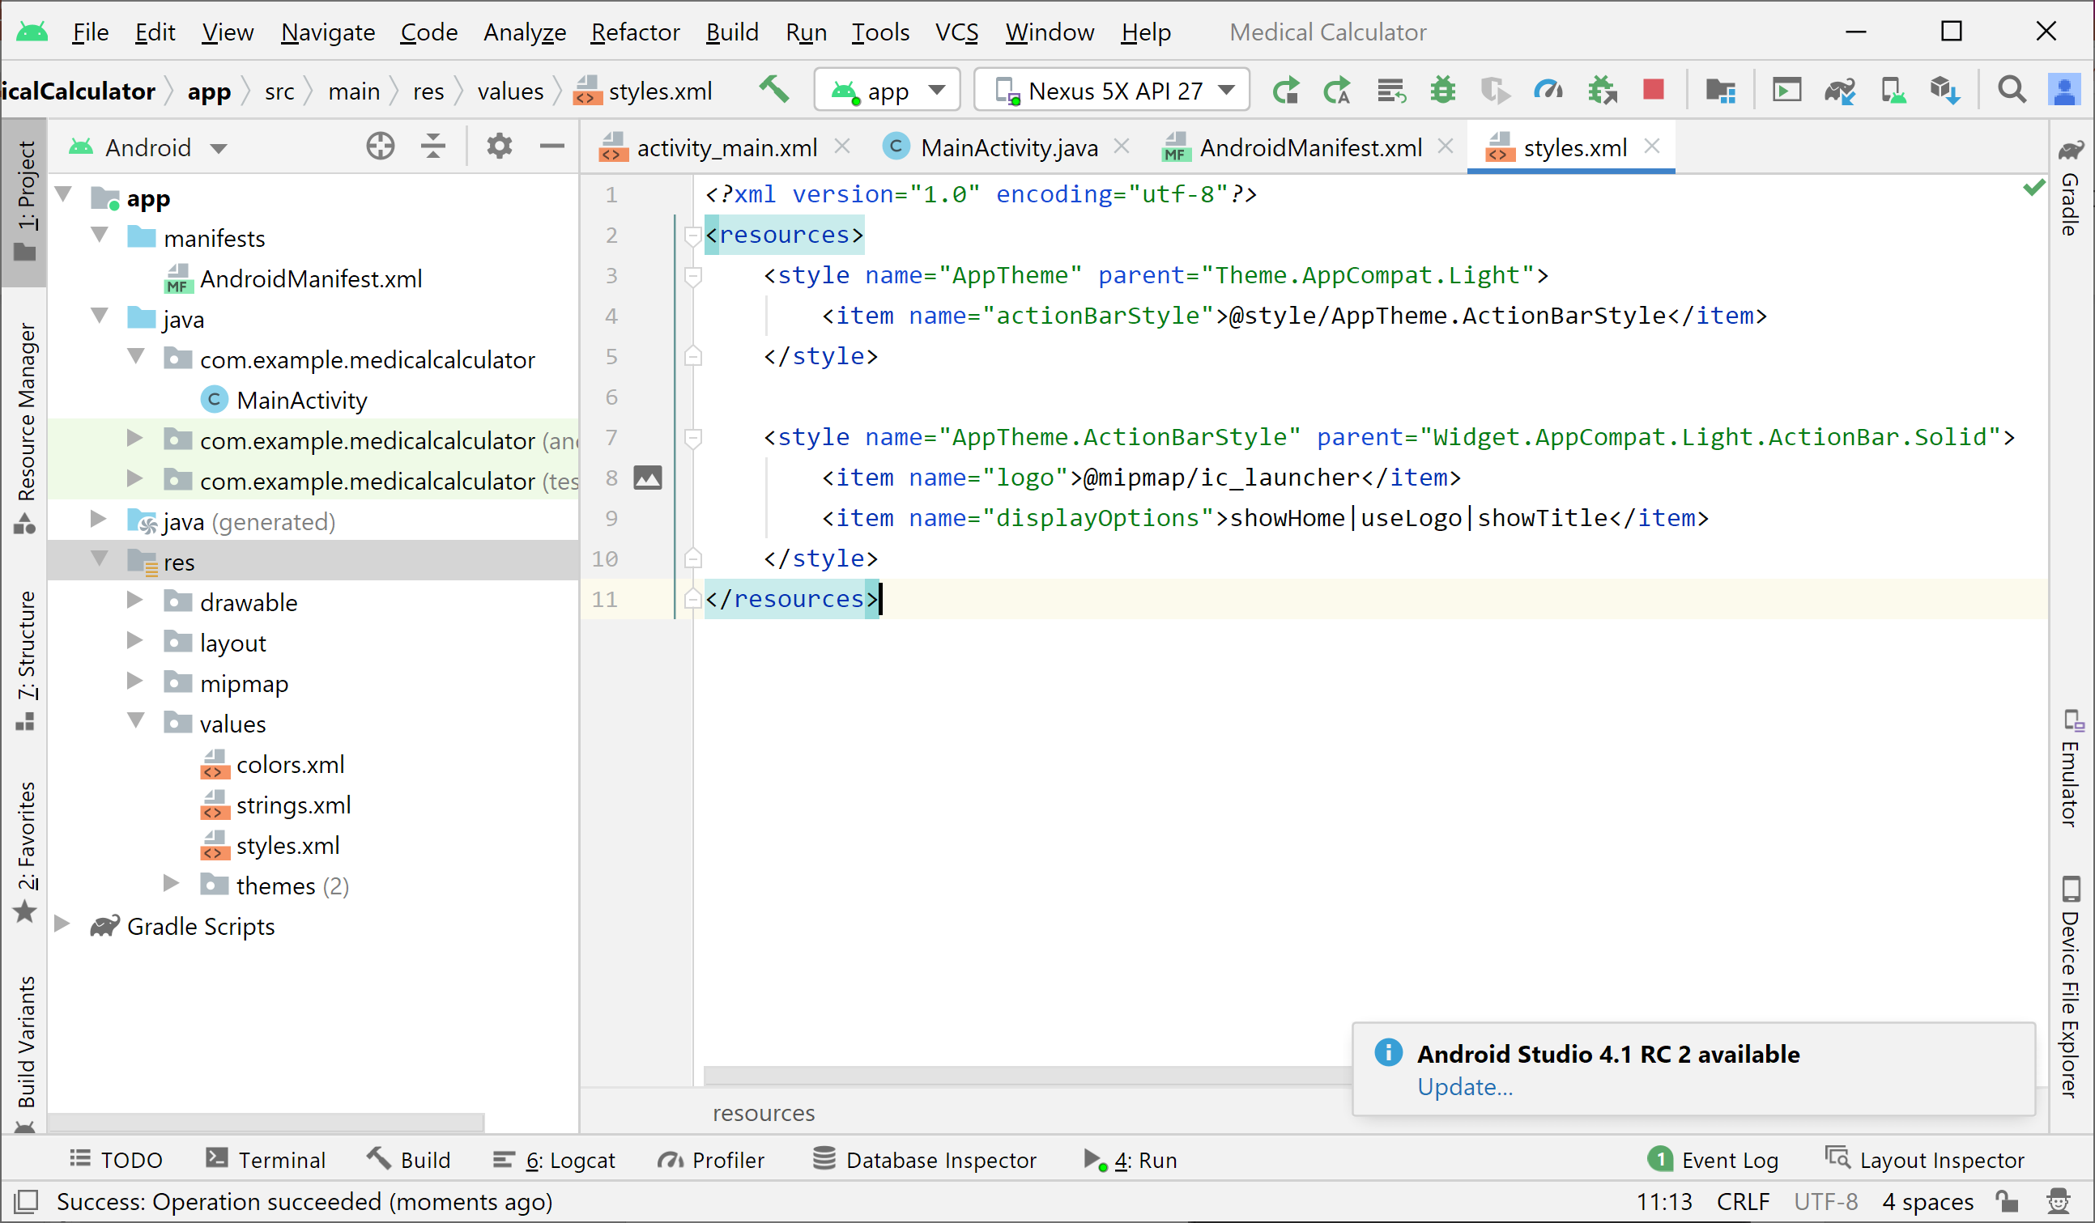
The Launcher Icon (continued)
styles.xml

Slide 13
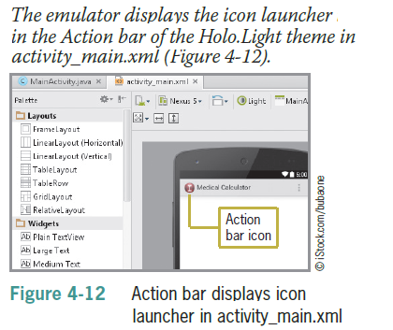
The Launcher Icon (continued)
An Action bar icon as shown in Figure 4-12 is considered a logo that represents what the program’s function is in a single glance; for example, the medical scale conveys the purpose and identity of the app.

Slide 14
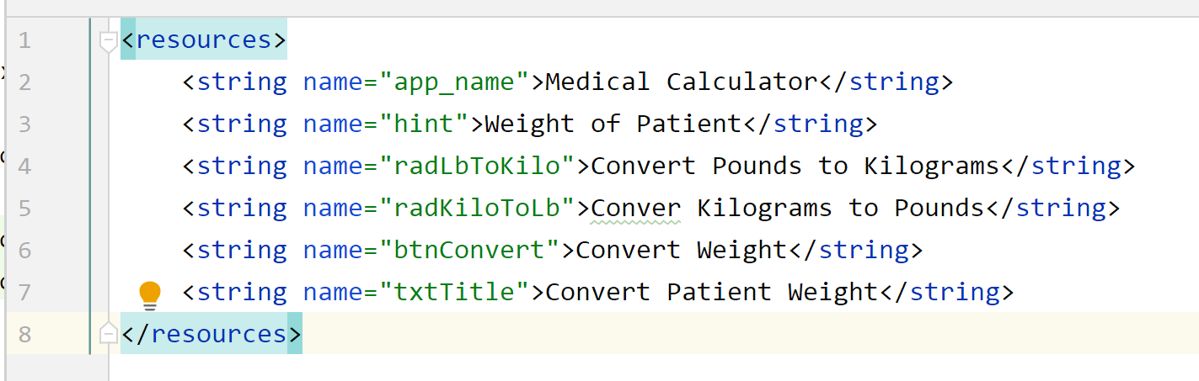
String Table
String resources are stored within the /res/values/strings.xml file
Any strings you add to the strings.xml file are accessible within your application

Slide 15
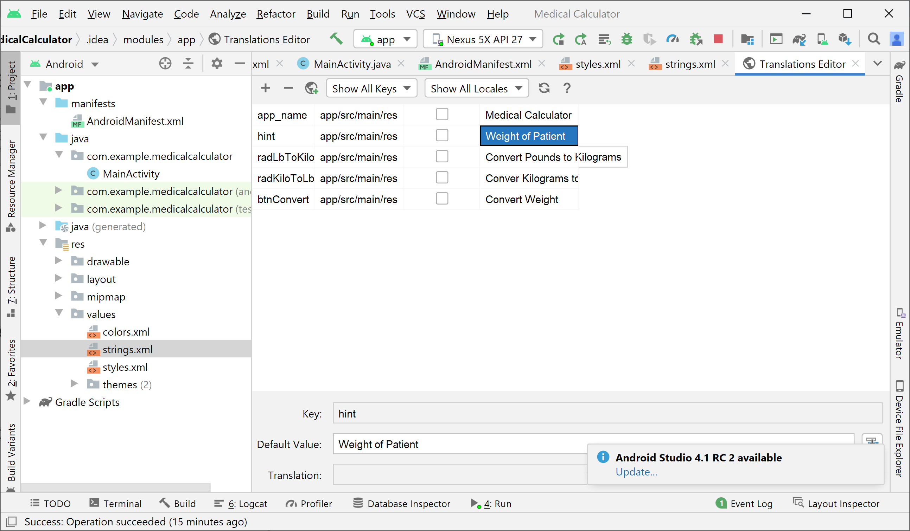
String Table (continued)

Slide 16
RadioButton and RadioGroup Controls
A RadioButton control selects or deselects an option
Can be arranged horizontally or vertically
Have a label defined by the text property
Can be initially set to checked or unchecked
Typically used together in a RadioGroup
Only one RadioButton in the group can be selected at a time
Good to offer a default selection (checked = true) for the option that is used most

Slide 17
Changing the Text Color of Android Controls
Use hexadecimal color codes to represent RGB (Red, Green, Blue) values
Codes range from 00 to FF (00 = none, FF = full)
Codes are identified by a pound sign, followed by the RGB values
#FF0000 is all RED
#00FF00 is all GREEN
#0000FF is all BLUE
#FFFF00 is YELLOW (RED and GREEN = YELLOW)

Slide 18
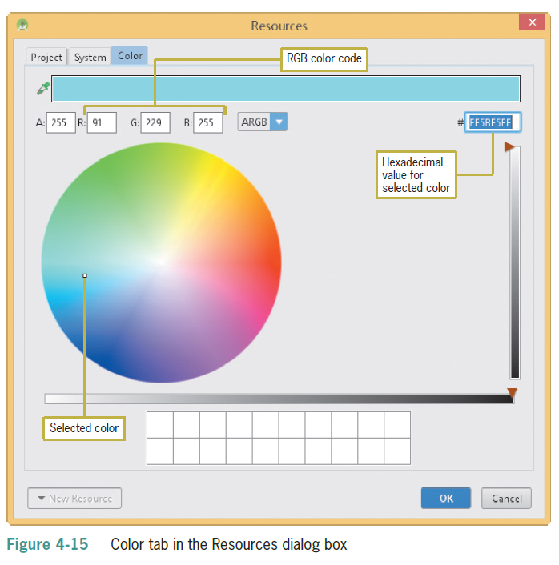
Changing the Text Color of Android Controls (continued)

Slide 19
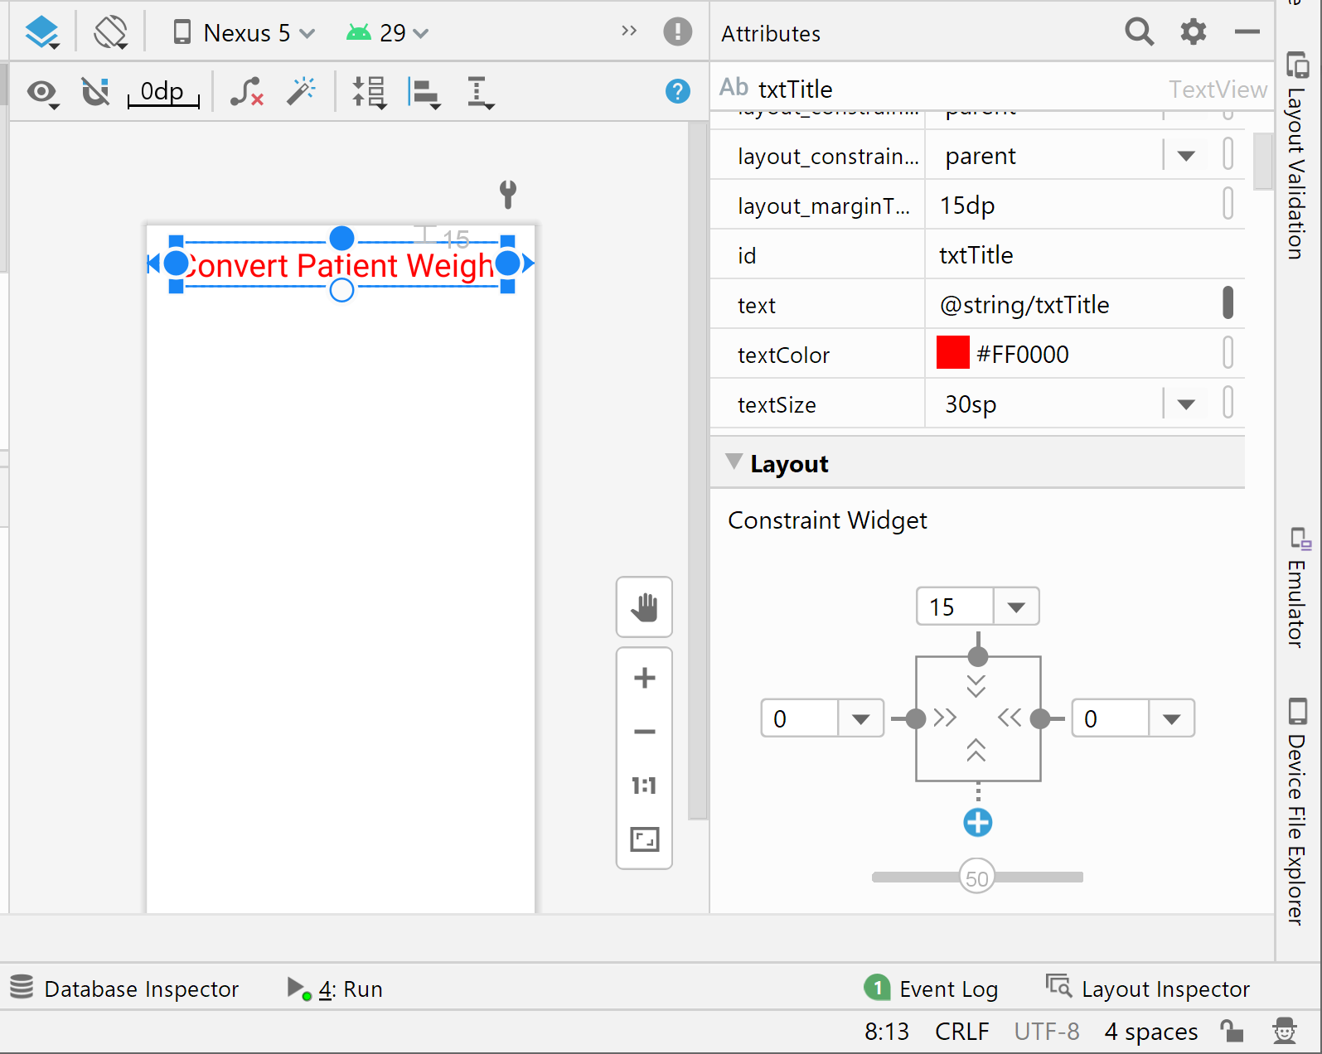
Changing the Text Color of Android Controls (continued)
Attributes added
Constraints

Slide 20
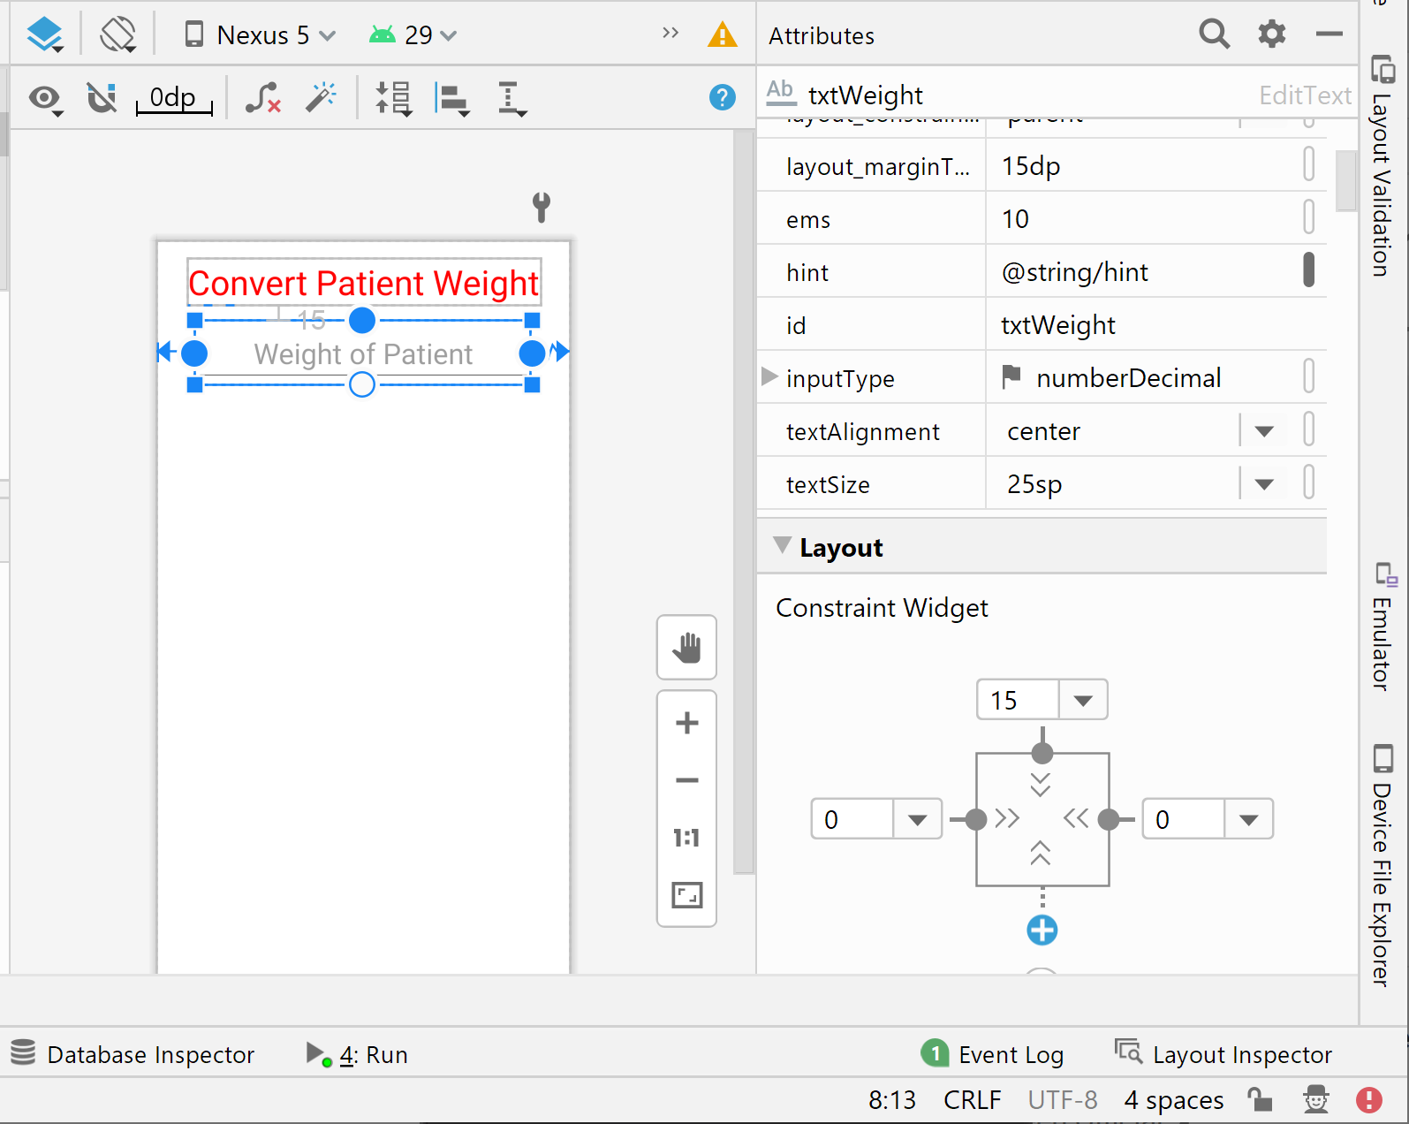
Adding the RadioButton Group
Use the prefix rad to name the control
Attributes added
Constraints

Slide 21
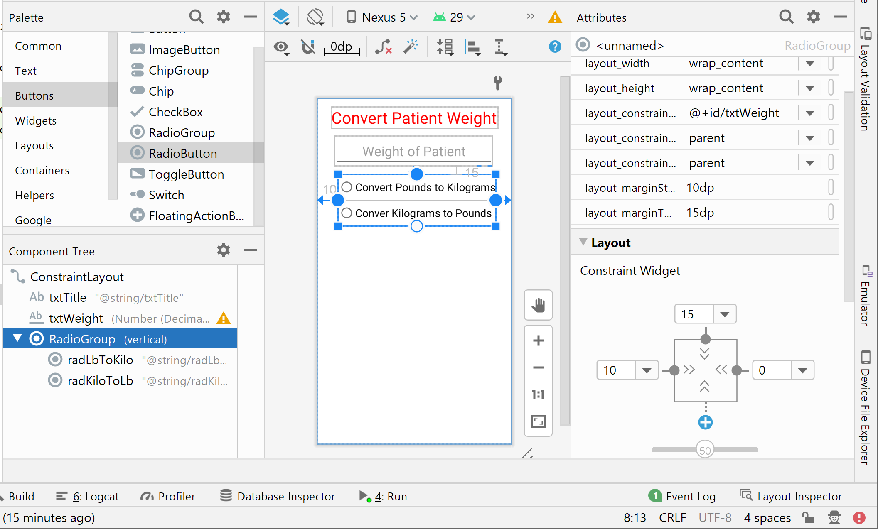
Adding the RadioButton Group (continued)
Constraints
Constraints

Slide 22
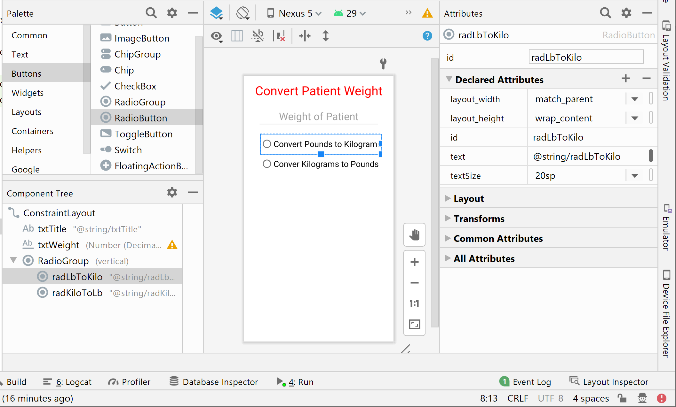
Adding the RadioButton Group (continued)
attributes
Constraints

Slide 23
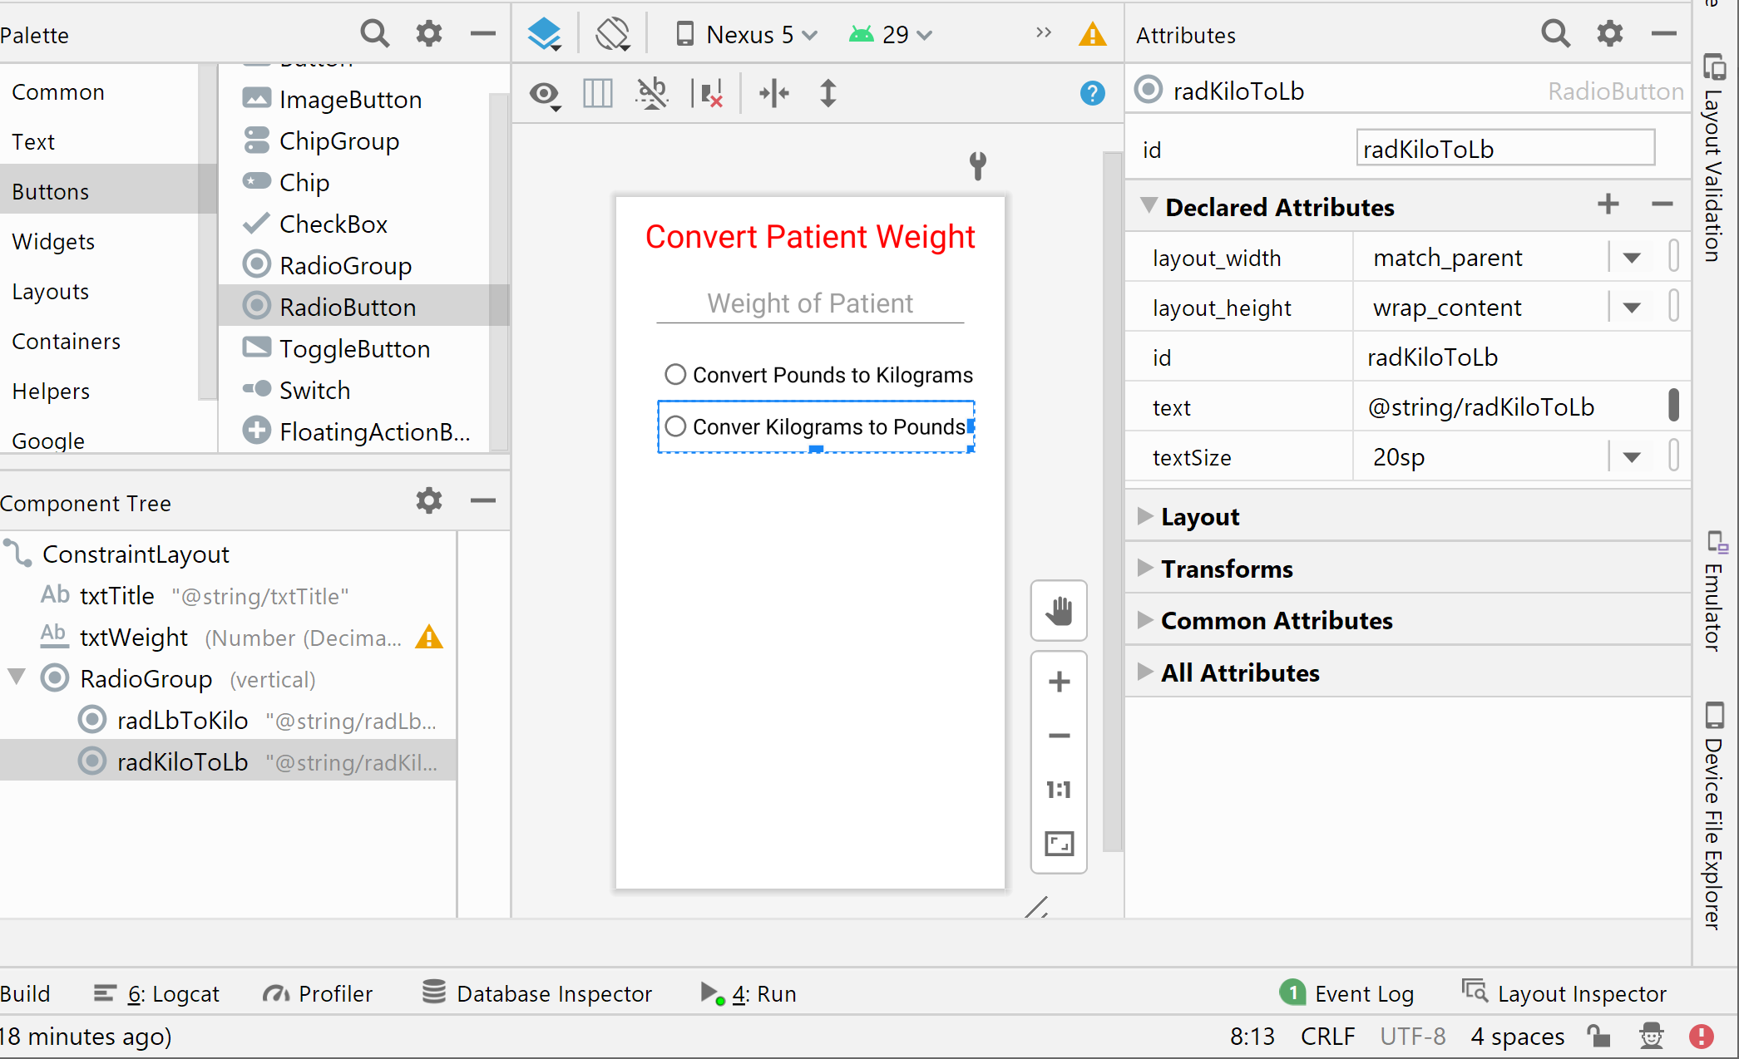
Adding the RadioButton Group (continued)
attributes
Constraints

Slide 24
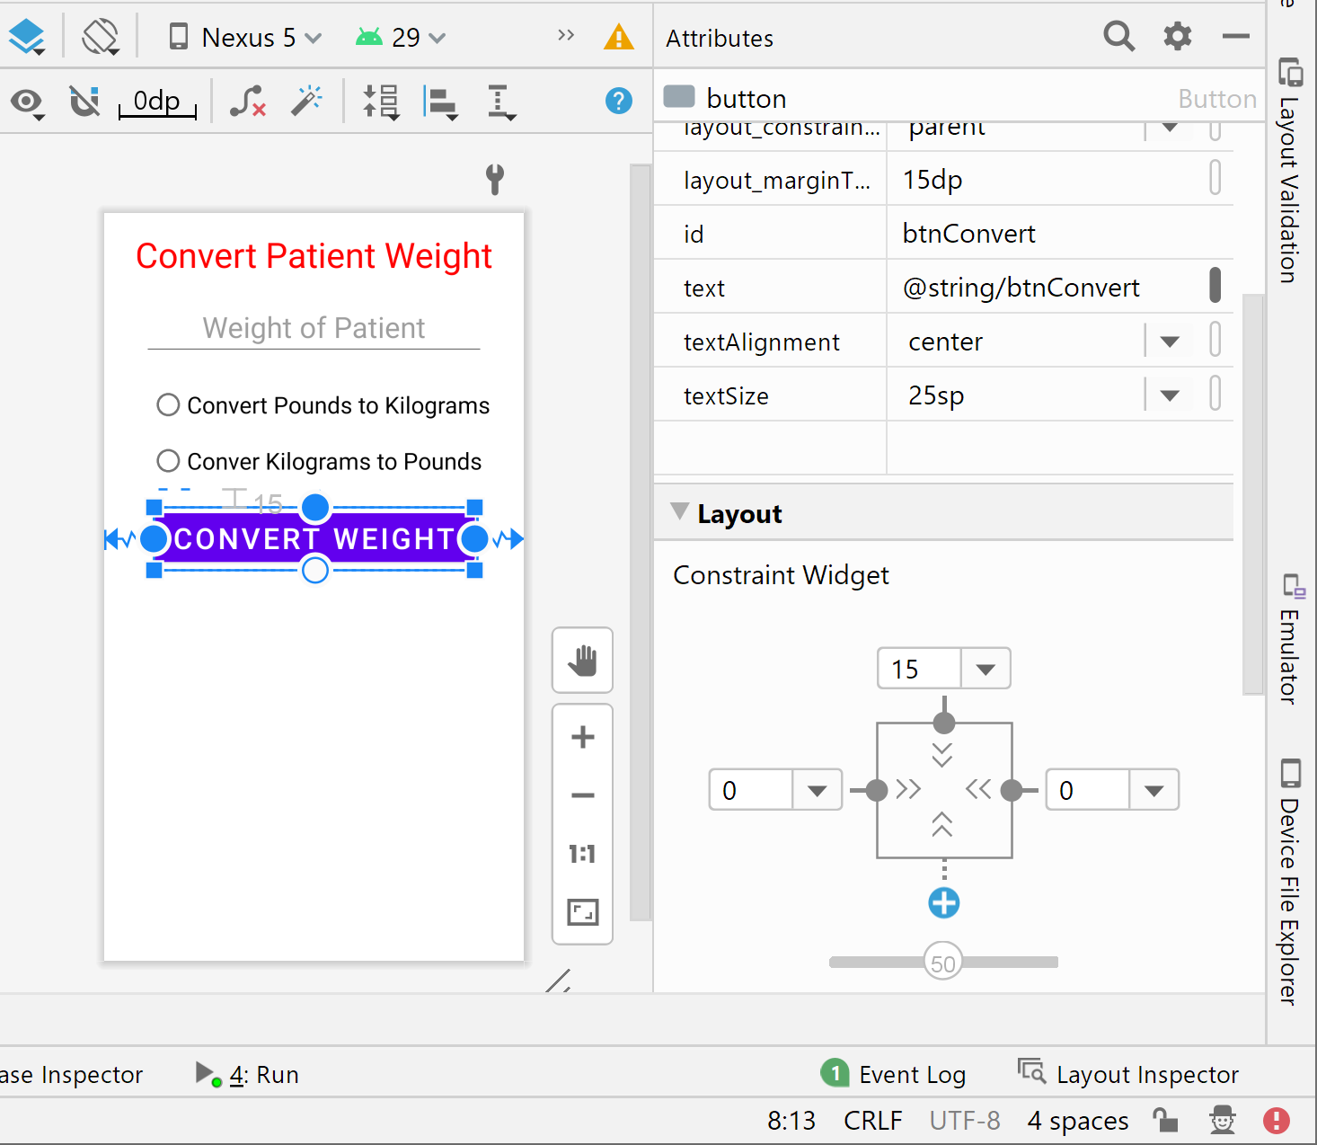
Completing the User Interface
attributes
Constraints

Slide 25
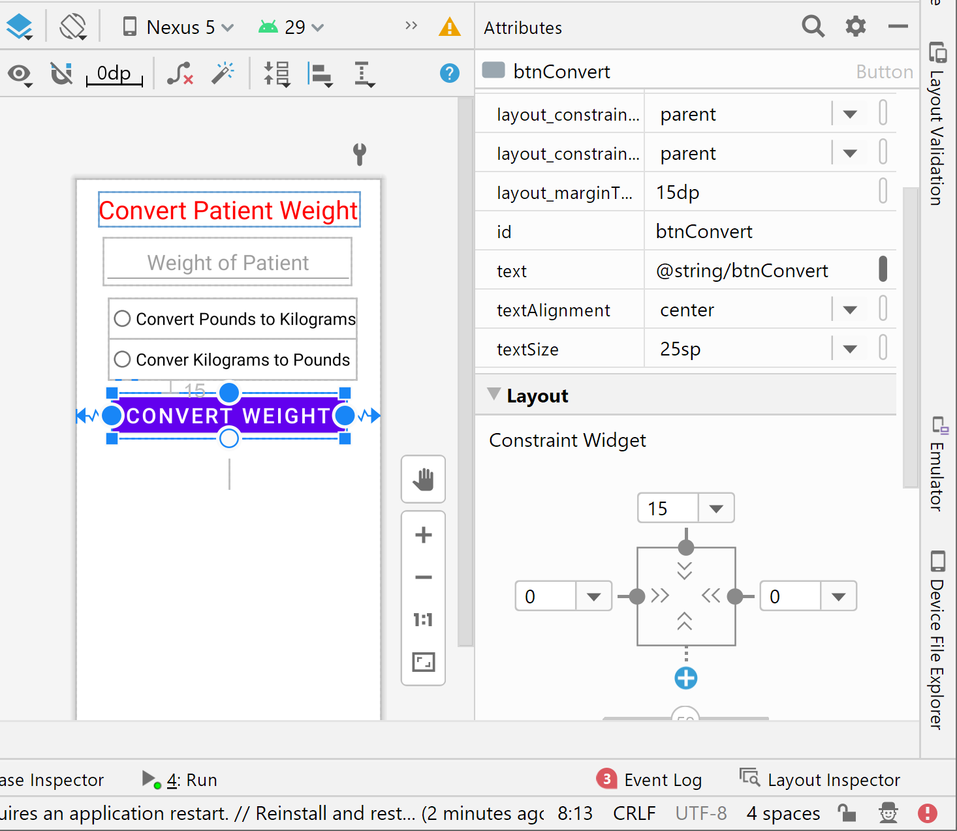
Completing the User Interface
attributes
Constraints

Slide 26
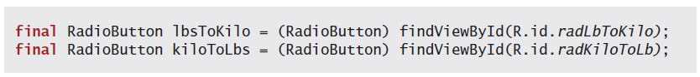
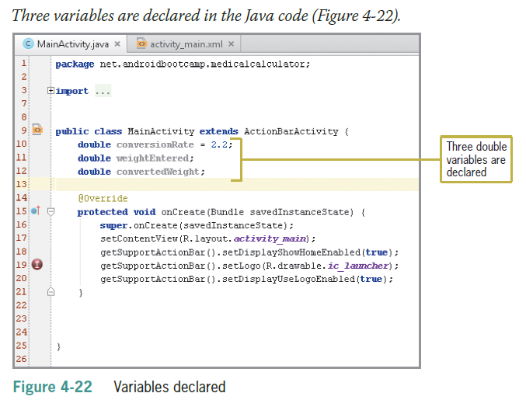
Coding a RadioButton Control

Slide 27
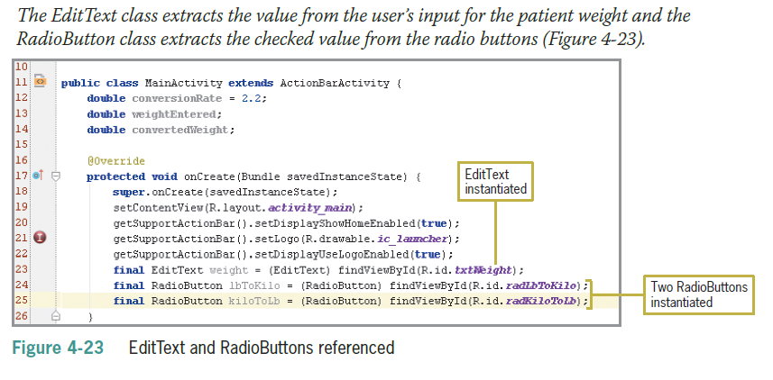
Coding a RadioButton Control (continued)

Slide 28
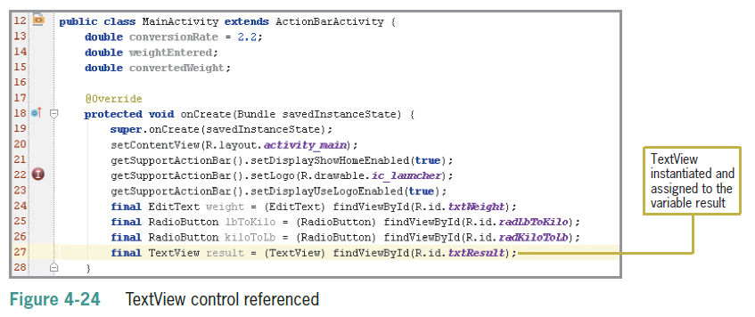
Coding the Button Control

Slide 29
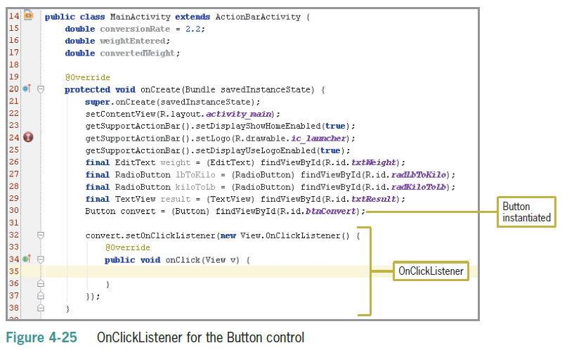
Coding the Button Control (continued)

Slide 30
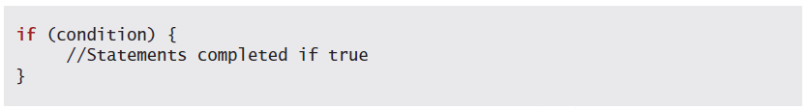
Making Decisions with Conditional Statements
Decision structures are used to test conditions
Using an If Statement
Statements between the opening and closing braces are executed if the condition is true

Slide 31
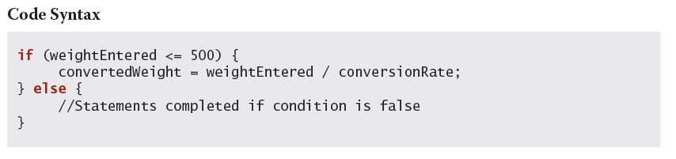
Using If Else Statements
One set of statements are executed if the condition is true and a different set of statements are executed if the condition is false

Slide 32
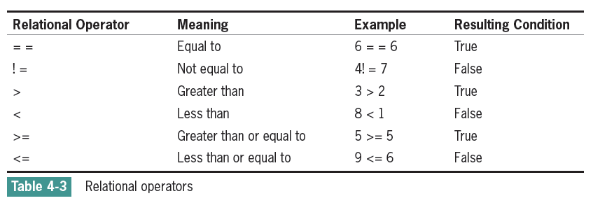
Relational Operators
Java strings are compared with the equals method (==) of the string class

Slide 33
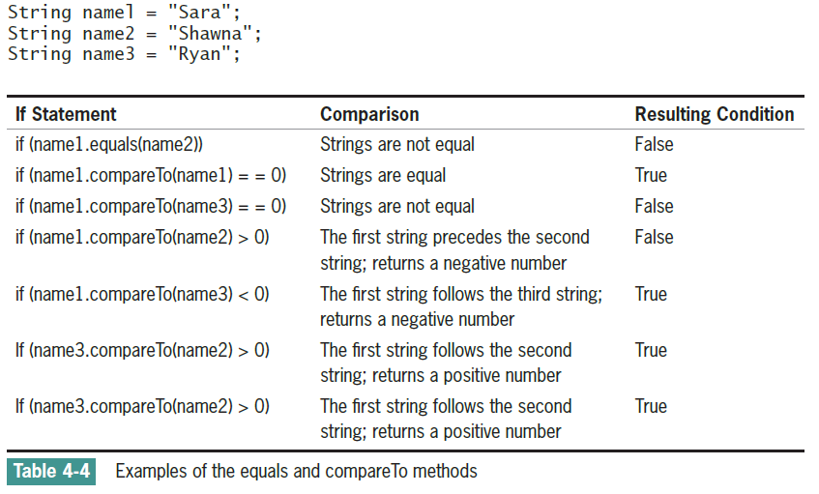
Relational Operators (continued)

Slide 34
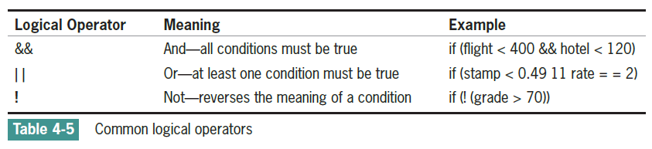
Logical Operators
When more than one condition is tested the conditions are called a compound condition

Slide 35
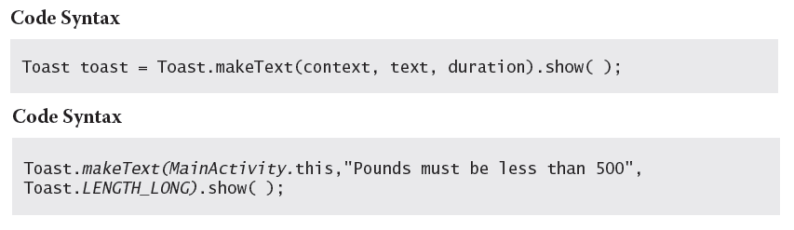
Data Validation and Toast Notifications
Data Validation
User entries must be checked for reasonable values
Toast Notification
A toast notification communicates messages to the user (message slides upward into view like toast popping out of a toaster)

Slide 36
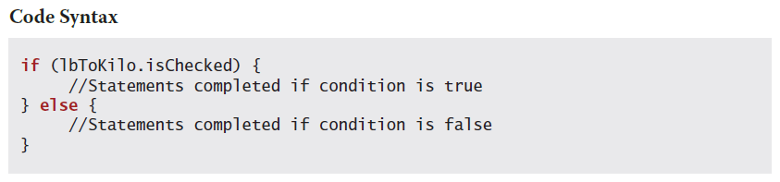
Using the isChecked() Method of RadioButton Controls
The isChecked() method determines if the RadioButton object has been selected

Slide 37
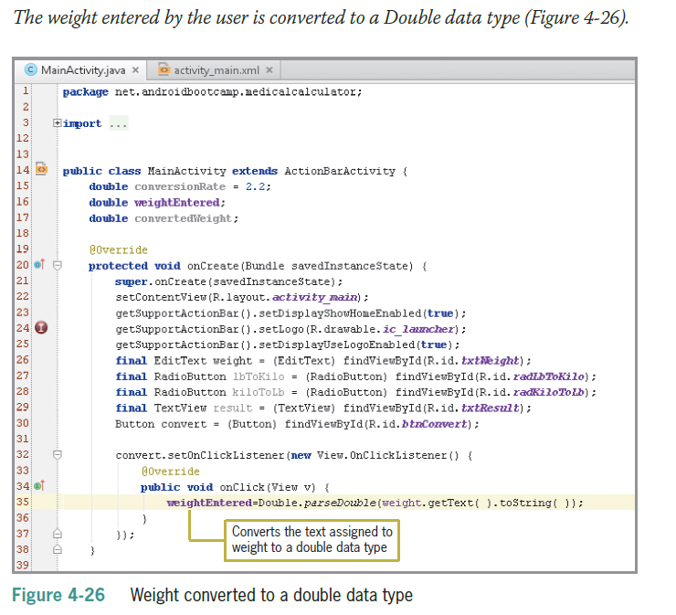
Coding the Button Event
The syntax Double.parseDouble converts input to a Double data type and Integer.parseInt converts input to an Integer data type

Slide 38
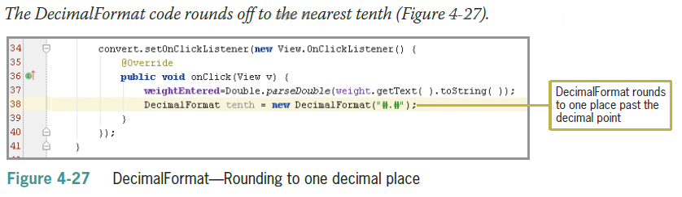
Coding the Button Event (continued)

Slide 39
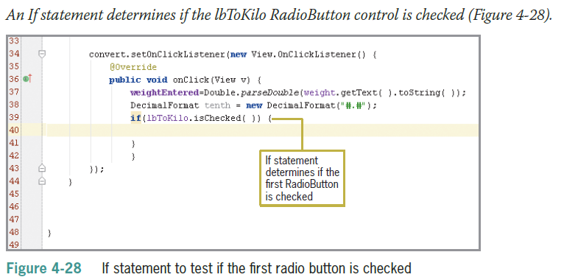
Coding the Nested If Statements
If statements are nested when one if statement is inside of another if statement

Slide 40
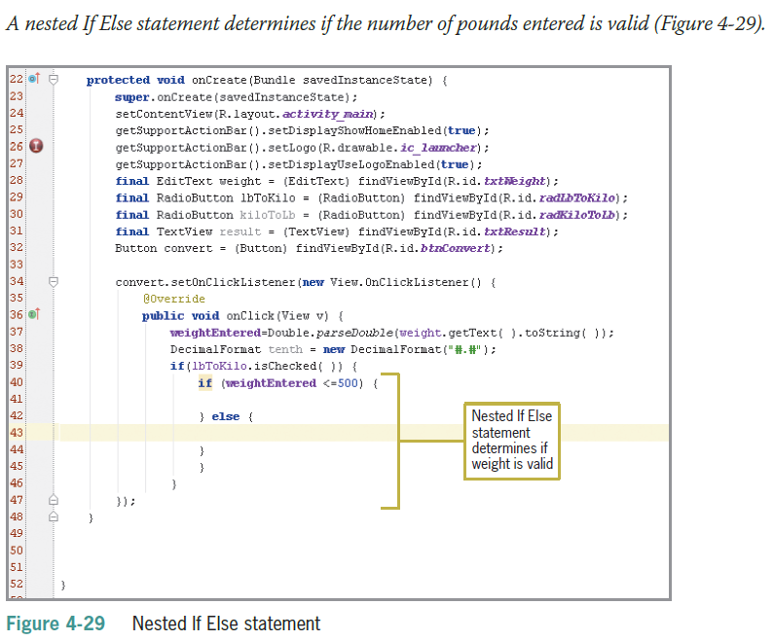
Coding the Nested If Statements (continued)

Slide 41
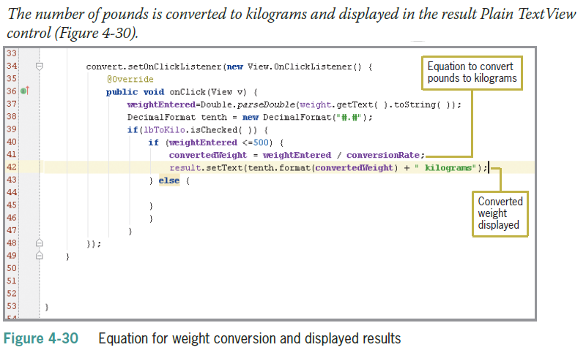
Coding the Nested If Statements (continued)

Slide 42
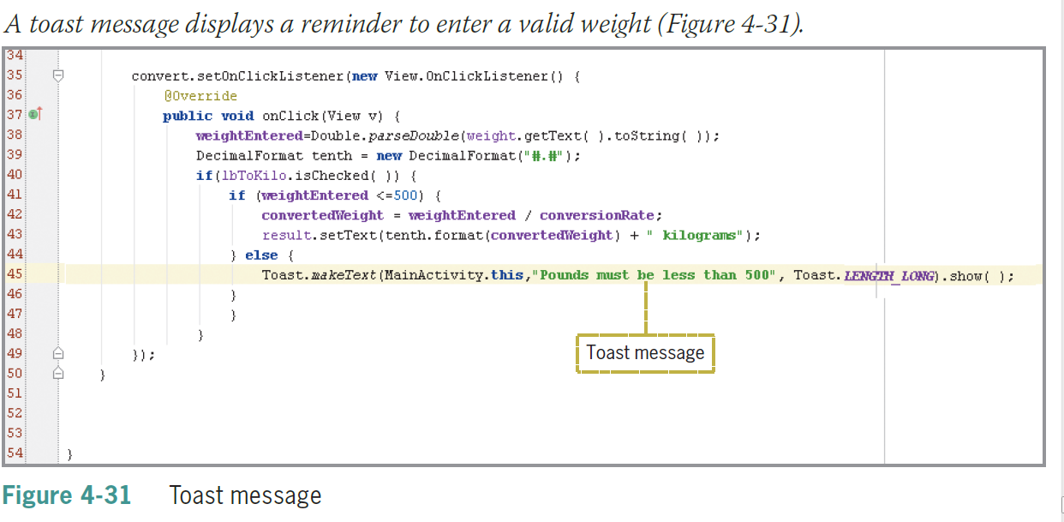
Coding the Nested If Statements (continued)

Slide 43
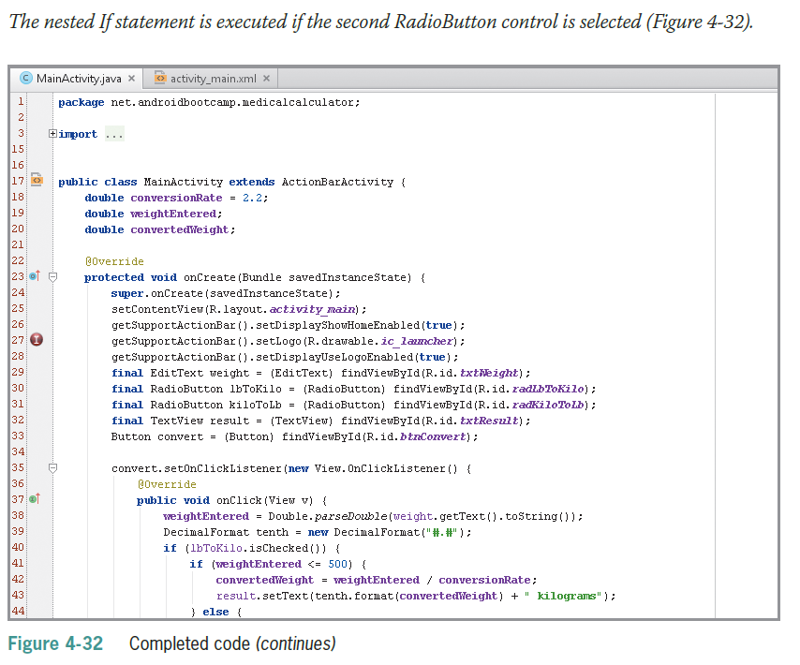
Coding the Nested If Statements (continued)

Slide 44
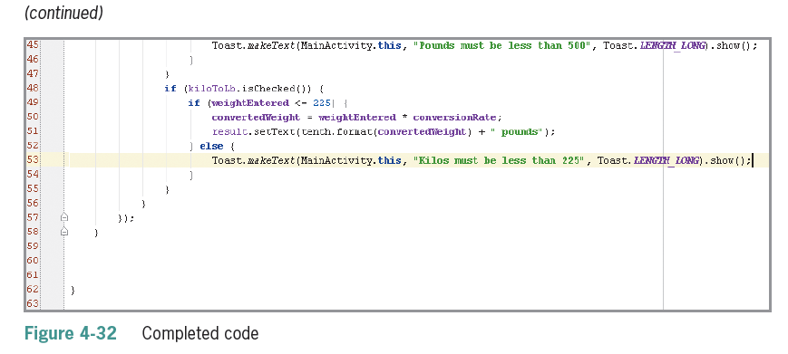
Coding the Nested If Statements (continued)

Slide 45
Radiobutton Click Events
Link a method with a radio button in XML file using
android:onClick="onRadioButtonClicked”

Slide 46
Radiobutton Click Events
In Java file add following code
public void onRadioButtonClicked(View view) {
// Check which radio button was clicked
switch(view.getId()) {
case R.id.radio_pirates:
// Pirates are the best
break;
case R.id.radio_ninjas:
// Ninjas rule
break;
}
}

Slide 47
Summary
To display a custom launcher icon instead of the default icon on the home screen of an Android device, tap or click Image Asset on the New menu to open the Asset Studio dialog box
Include RadioButton controls to allow users to select or deselect options – only one button can be selected at a time
Android apps use hexadecimal color codes
Use the layout:margin property to change the spacing between objects

Slide 48
Summary (continued)
If statements execute statements if a condition is true
If Else statements execute one group of statements if a condition is true and different group of statements if the condition is false
Relational operators are used within the conditional statement
Compound conditions must use logical operators such as && (And)

Slide 49
Summary (continued)
Toast notifications display a brief message to a user
Use nested If statements to test a second condition only after determining that a first condition is true or false

